Slide 1
How to Host a Pondering
2 Sample Agendas

Slide 2
Purpose – How to structure your Pondering Pub?
The purpose of The Pondering Pub is community creation. By hosting this Pondering, you are helping develop genuine human connections that go beyond mere coworker friendships that end at 5:00 or “communities” based off ideology.
The Pondering Pub excels at community creation. We do this by encouraging one another to make the world a more beautiful place, either by creating new things or reflecting on the old.
Remember this. If a community is already in place, what is the need?
  Maybe you’re bringing 2 communities together. Maybe you’re bringing people together beyond mere student/coworker status. Maybe you’re connecting an eclectic group of people you know.
  Keep this in mind as you set your agenda. Already established communities = keep the objective of advancing beauty more in mind. New people getting to know each other = set time for socializing to occur.

Slide 3
Praxis
So what does that look like?
All good ideas have structure.
Set your agenda based on the needs of your Pondering.
If people know each other already, the structure serves what already exists, and is used to “keep things moving.” (Example 1)
If people don’t know each other well, the structure provides order, and lets everyone know what a Pondering ~should~ look like. (Example 2)

Slide 4
Example 1
The Dumb Ox – Friends who already know each other

Slide 5
The Agenda looks like this
Arrival
Beginning – Prayer. Announcements.
Structured Presentations
  College Insights
  Ongoing Artistic Endeavors
  Pre-announced Presentations
Sporadic Presentations
Schedule next Pondering
End
These guys know what to expect each week, so the structure is there to keep things moving and gives everyone direction.

Slide 6
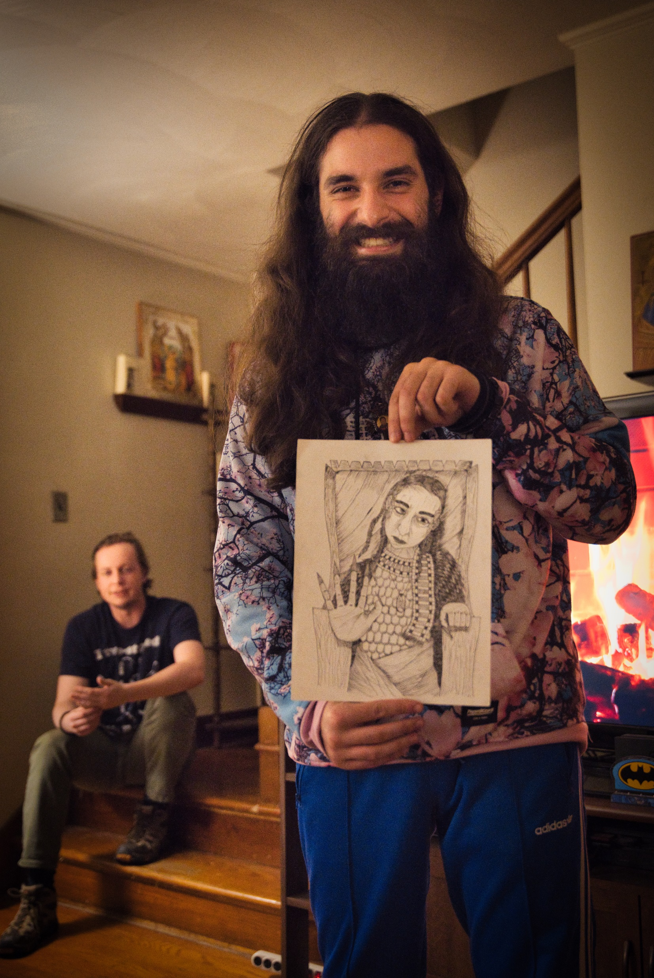
Overview – An Individual Pondering
The Pondering Pub is comprised of various “Pubs” (community meeting places) which host “Ponderings” (events at these community meeting places)
At a Pondering, any community member may share a work of Truth, Beauty, or Goodness, that they found or created and wish to share with others.
These meetings are based upon Christ, but the presentations need not focus entirely upon Christianity. Any aspect of Truth, Beauty, or Goodness may be the subject of discussion during a presentation.

Slide 7
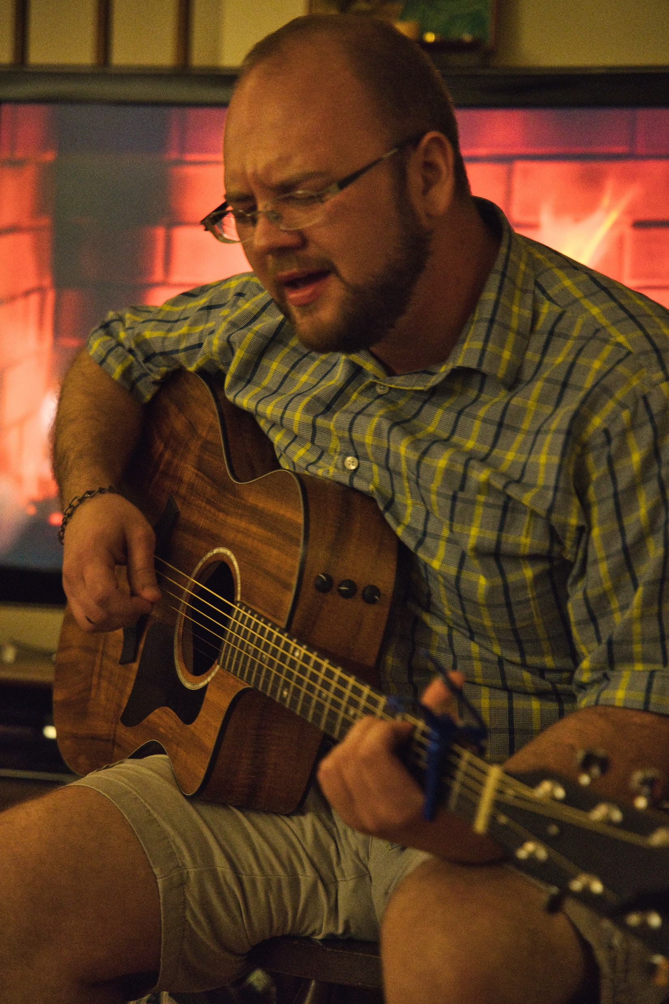
Example 1: The Dumb Ox
This Pub is comprised of 9 members. They’ve known each other for years, and most of them are fresh out of college. They meet at 9:00 PM on Fridays.
Some people show up at 9:00 and talk about their week. It begins around 9:30, once everyone has finally shown up. The group starts with scheduled presentations, followed by sporadic. The Host lets people know it’s start time by leading everyone in prayer.
Ongoing Artistic Endeavors. Anthony has been writing a book. Everyone checks in on him to ask about updates and keep him accountable. He reads a draft of what he’s working on.
Pre-announced Presentations. Josh told the Pub Rep he had a presentation he wanted to give. He goes next, sharing a song he came across. Everyone gives rapt attention, Q+A follow, then side-conversations break out for 20 minutes.
Educational Insights. Afterwards, the Pub Reps asks if anyone has a cultural event they want to process or share something they recently learned. Dan + Mel are still in college, so if they have anything they want to discuss within a Christian context, they get the floor.

Slide 8
Example 2
The Stone and the Giant – Growing with Newcomers

Slide 9
The Agenda looks like this
Arrival
Beginning – Prayer. Announcements.
Presentations
  Music
  Art
  Literature
  Presentations
  Conversation
Schedule next Pondering
End
This is great for when there is a lot of excitement and no fear of having too few presentations. In this example, the Pub is just starting out, and everyone has a backlog of what they want to share (such as old high school or college assignments.) It’s ok not to have everything planned out, because people are really excited to bring things to share within an authentic environment.

Slide 10
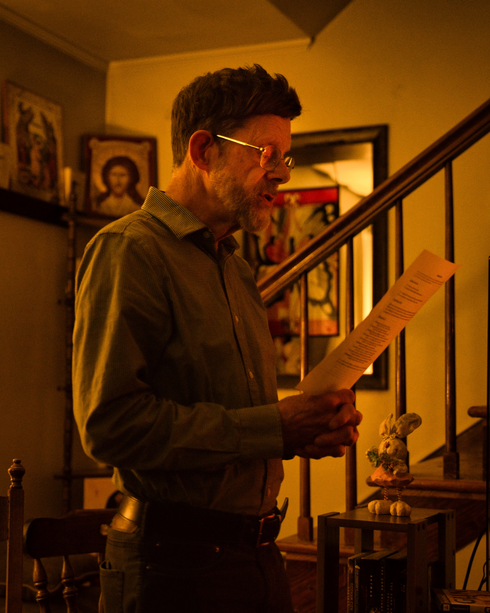
Example 2: The Stone and the Giant
The Stone and the Giant’s Pondering
This Pub has about 10 people show up weekly, but 5 people make up its core. These 5 knew each other for years and decided to start their own Pondering. Since there are so many newcomers, they’ve decided to create a structure that works regardless of who shows up.
Everyone is a few years out of college, so they decide to meet at 6:30. Some people bring snacks.
Seth and Anna typically show up with something. 1 of the core couldn’t make it due to traveling for work, but there are 5 people who are new to the Pondering who came.

Slide 11
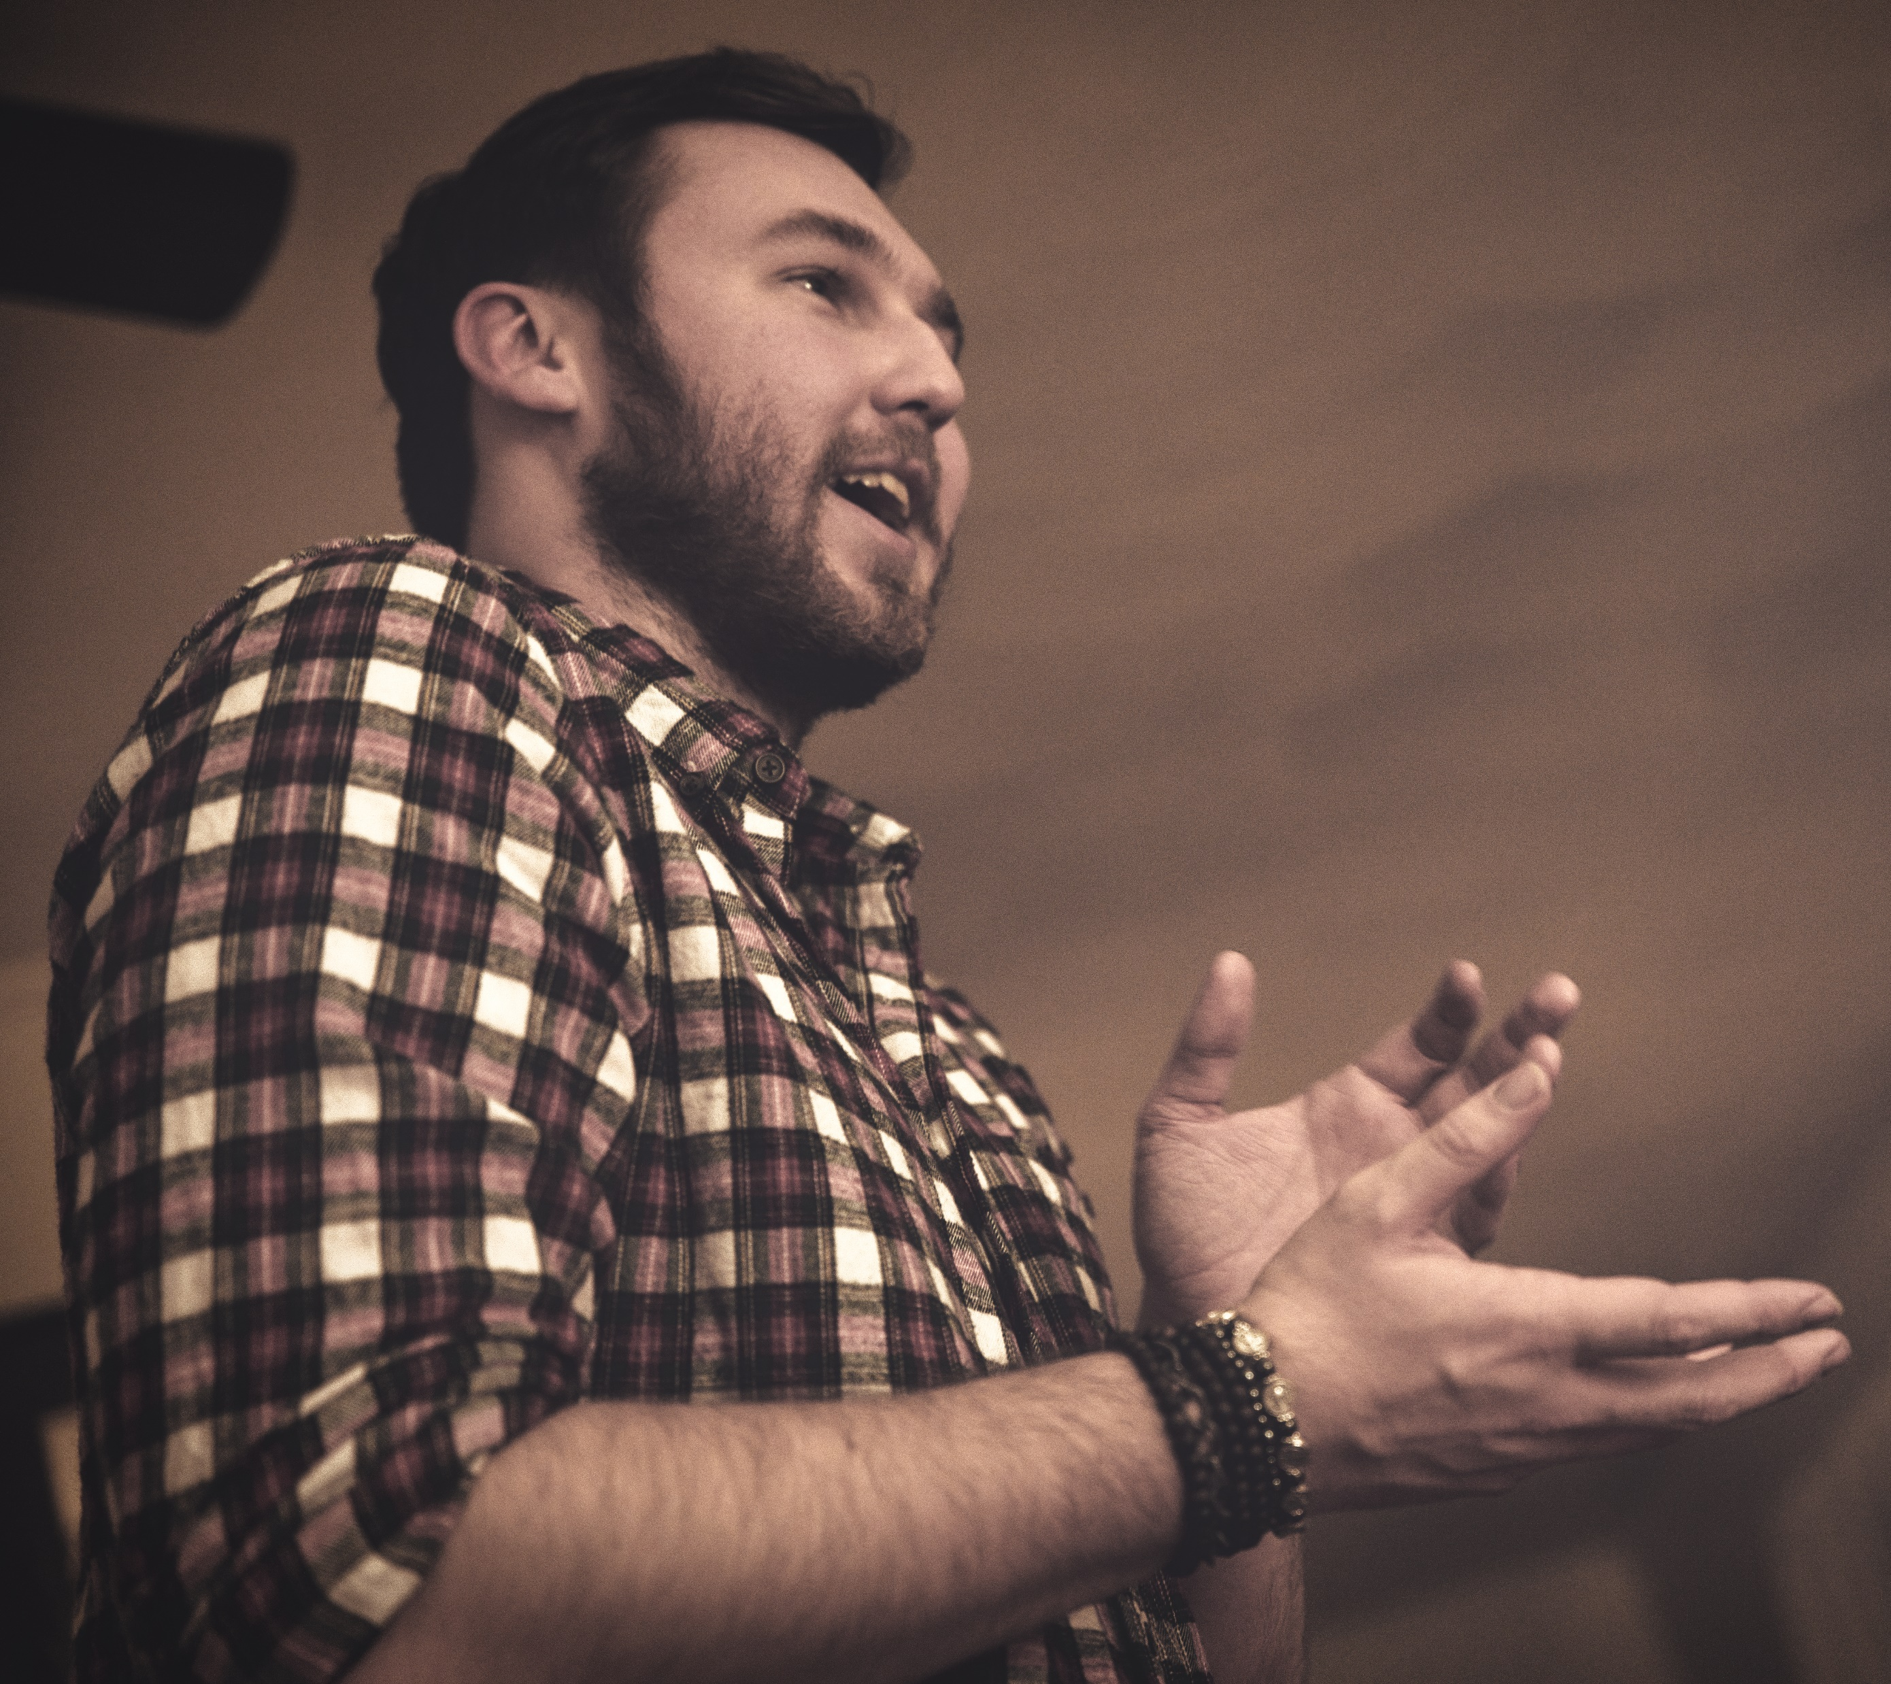
Example 2: The Stone and the Giant
Everyone meets in a public place. The Host calls people to order at 6:30 an opens in prayer. He then asks if anyone brought any music…any art…any literature…any presentations…any conversation topics.
  Joe raises his hand when art is called. Anna raises her hand for literature. Seth says he has a conversation piece.
Joe goes first, since everyone’s gathered together. This isn’t his first Pondering, but this is his first presentation. He’s liked this piece for a while, and wanted to share it with anyone.
  What’s important is the art piece if a part of the conversation. If the art is thrown out with no context, and no follow up, it’s a dead art piece. Joe is sharing not just an art piece, but part of his life.
Second is Anna. She wrote a short piece about friendship and reads it to the group. She begins by saying what inspired her to write the piece, then reads the piece, then people talk about it afterwards. The conversation goes all over the place.
Eventually, Seth finds a way to talk about his piece. He calls people to order. He saw a YouTube video that made him think. He talks about what made him want to share it with the group, then he shares the video, then talks about his thoughts. The conversation continues until 10:00, when the conversation reached its natural end. People end in prayer, and go home.

Slide 12
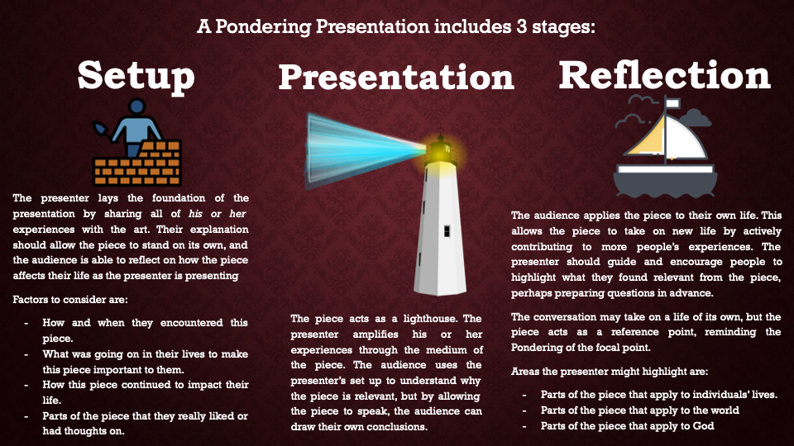

Slide 13
Overview of Examples
Your agenda system will change as the group dynamic changes. When the group is new, try the High-Energy Agenda. When the group has settled into a routine, try switching to the Structured Agenda.
Be very clear when you are switching and why. Talk to the Outreach Coordinator for ideas if you are hesitant about transitioning agendas.
Remember to schedule your next meeting date before you all depart! It’s way easier to schedule in person than over text.

