Slide 1
Pondering Pub Overview
This outlines the entire Pondering Pub Organization.

Slide 2
Purpose – What is the Pondering Pub?
The purpose of The Pondering Pub is creating communities that foster the arts.
In America, especially post-Covid, many people lack any form of community. What “community” they do have is either co-workers whose friendship ends at 5:00 or “communities” based off ideology. Neither of these are genuine.
What we did is explore how the earliest humans developed communities. What we found was most of them became formed through experiences with the Divine.
So what we do is weekly, we meet at a host’s house and discuss works of Truth, Beauty, and Goodness. All 3 of these transcendental values lead to God, and by touching them, we experience the Divine.

Slide 3
Praxis
So what does that look like?
All good ideas have structure to their manifestation.
This powerpoint is divided into 3 parts: an overview of the Organization, the layout of an individual Pondering, and the organizational Pondering as a whole.
The First part will cover how individual ponderings typically run, along with some examples of what has occurred at various Ponderings.
The Second part will go in depth on how individual Ponderings are structured, along with various policies they must follow, and tips that the leadership think are helpful for Founders.
The Third part will explain how the larger organizational structure operates.

Slide 4
Part 1
An Overview

Slide 5
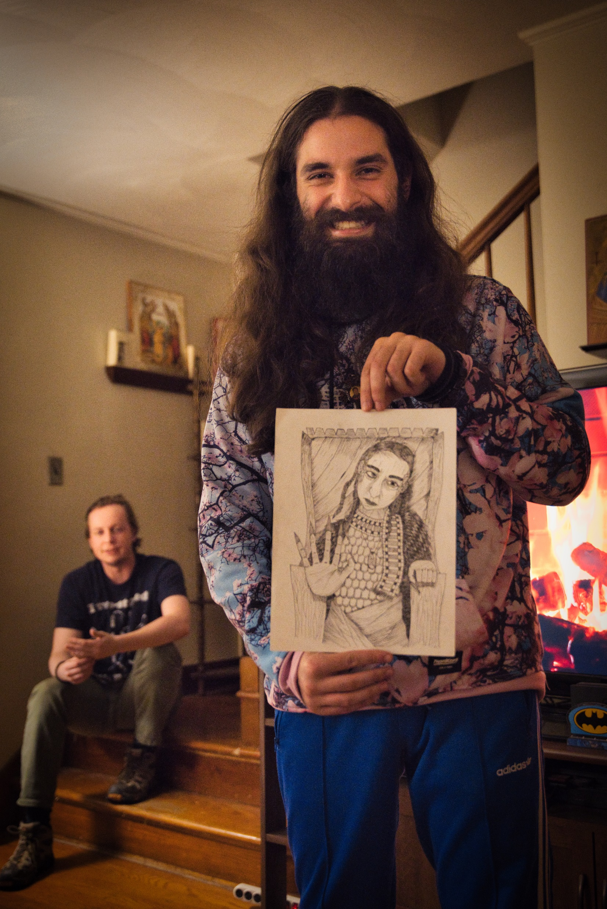
Overview – An Individual Pondering
The Pondering Pub is comprised of various “Pubs” (community meeting places) which host “Ponderings” (events at these community meeting places)
At a Pondering, any community member may share a work of Truth, Beauty, or Goodness, that they found or created and wish to share with others.
These meetings are based upon Christ, but the presentations need not focus entirely upon Christianity. Any aspect of Truth, Beauty, or Goodness may be the subject of discussion during a presentation.

Slide 6
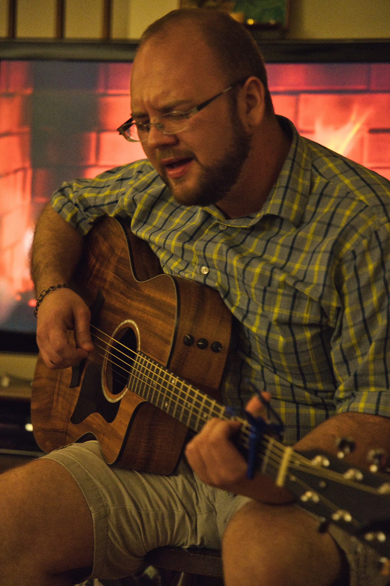
Example 1: The Dumb Ox
The Dumb Ox’s Pondering
This Pub is comprised of 9 members. It is a younger crowd, most of them fresh out of college, so they decide to meet at 9:00 PM on Fridays.
It begins around 9:30, once everyone has finally shown up. Henry leads everyone in prayer.
Tom plays the guitar. He plays a song he learned on the guitar, and reflects on some lyrics. Other people share their thoughts, and the discussion leads to a reflection of manual labor and intellectual labor.

Slide 7
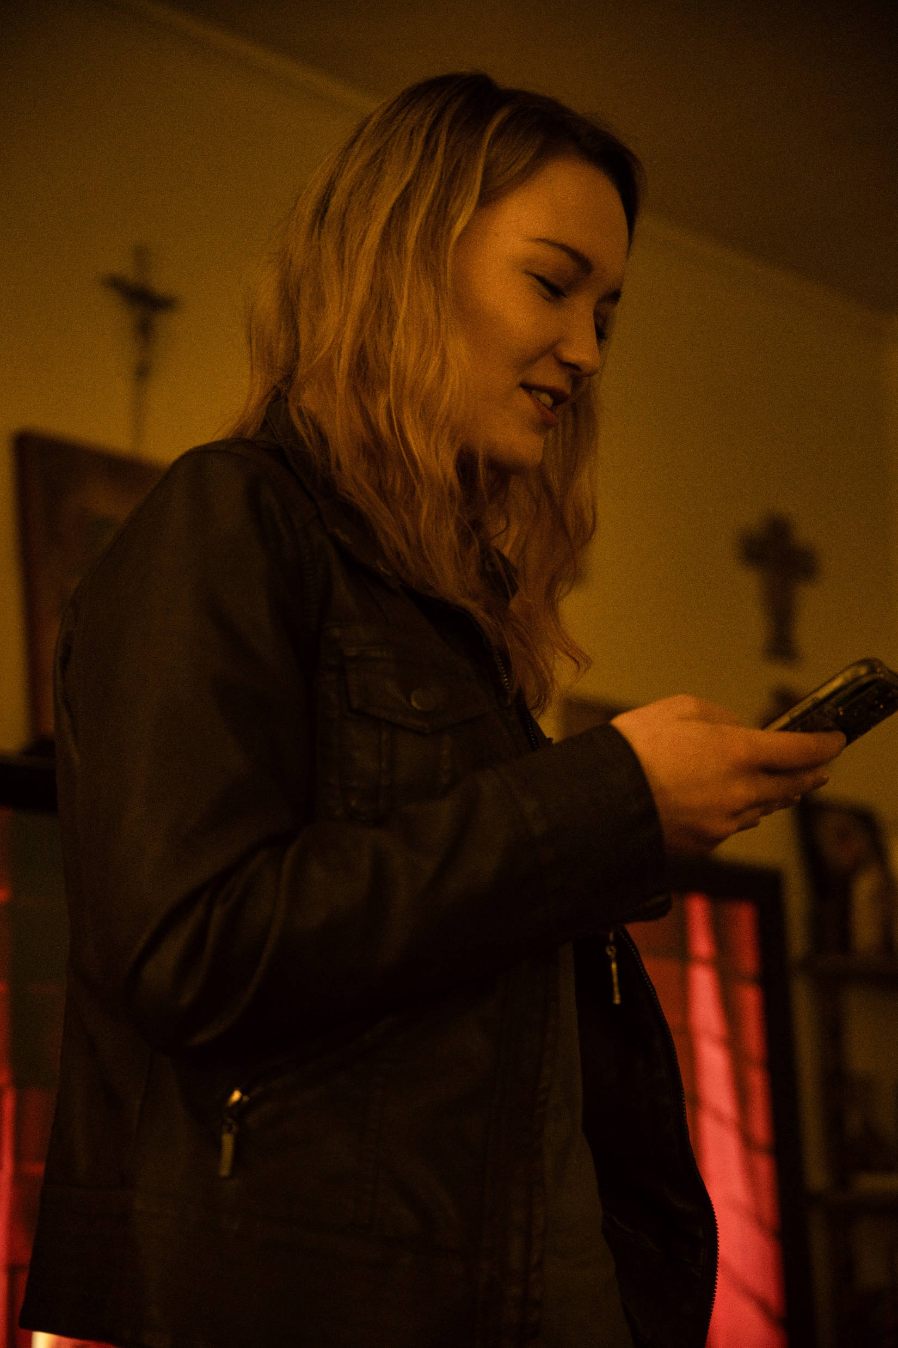
Example 1: The Dumb Ox
Elizabeth follows. She has been going through a difficult time, and wrote some poetry about it. This is her first time writing poetry, but she wants to communicate this feeling God has given her. She reads it twice.
Tim claims he isn’t creative. But he was reading something one day about time, and thought it valuable. He shared a passage from the book, and asked 2 discussion questions. People loved it and the discussion lasted 30 minutes.
Around 11:30, the presentations end. Since they’re all good friends and young, they talk and laugh until well past midnight, and then go home.

Slide 8
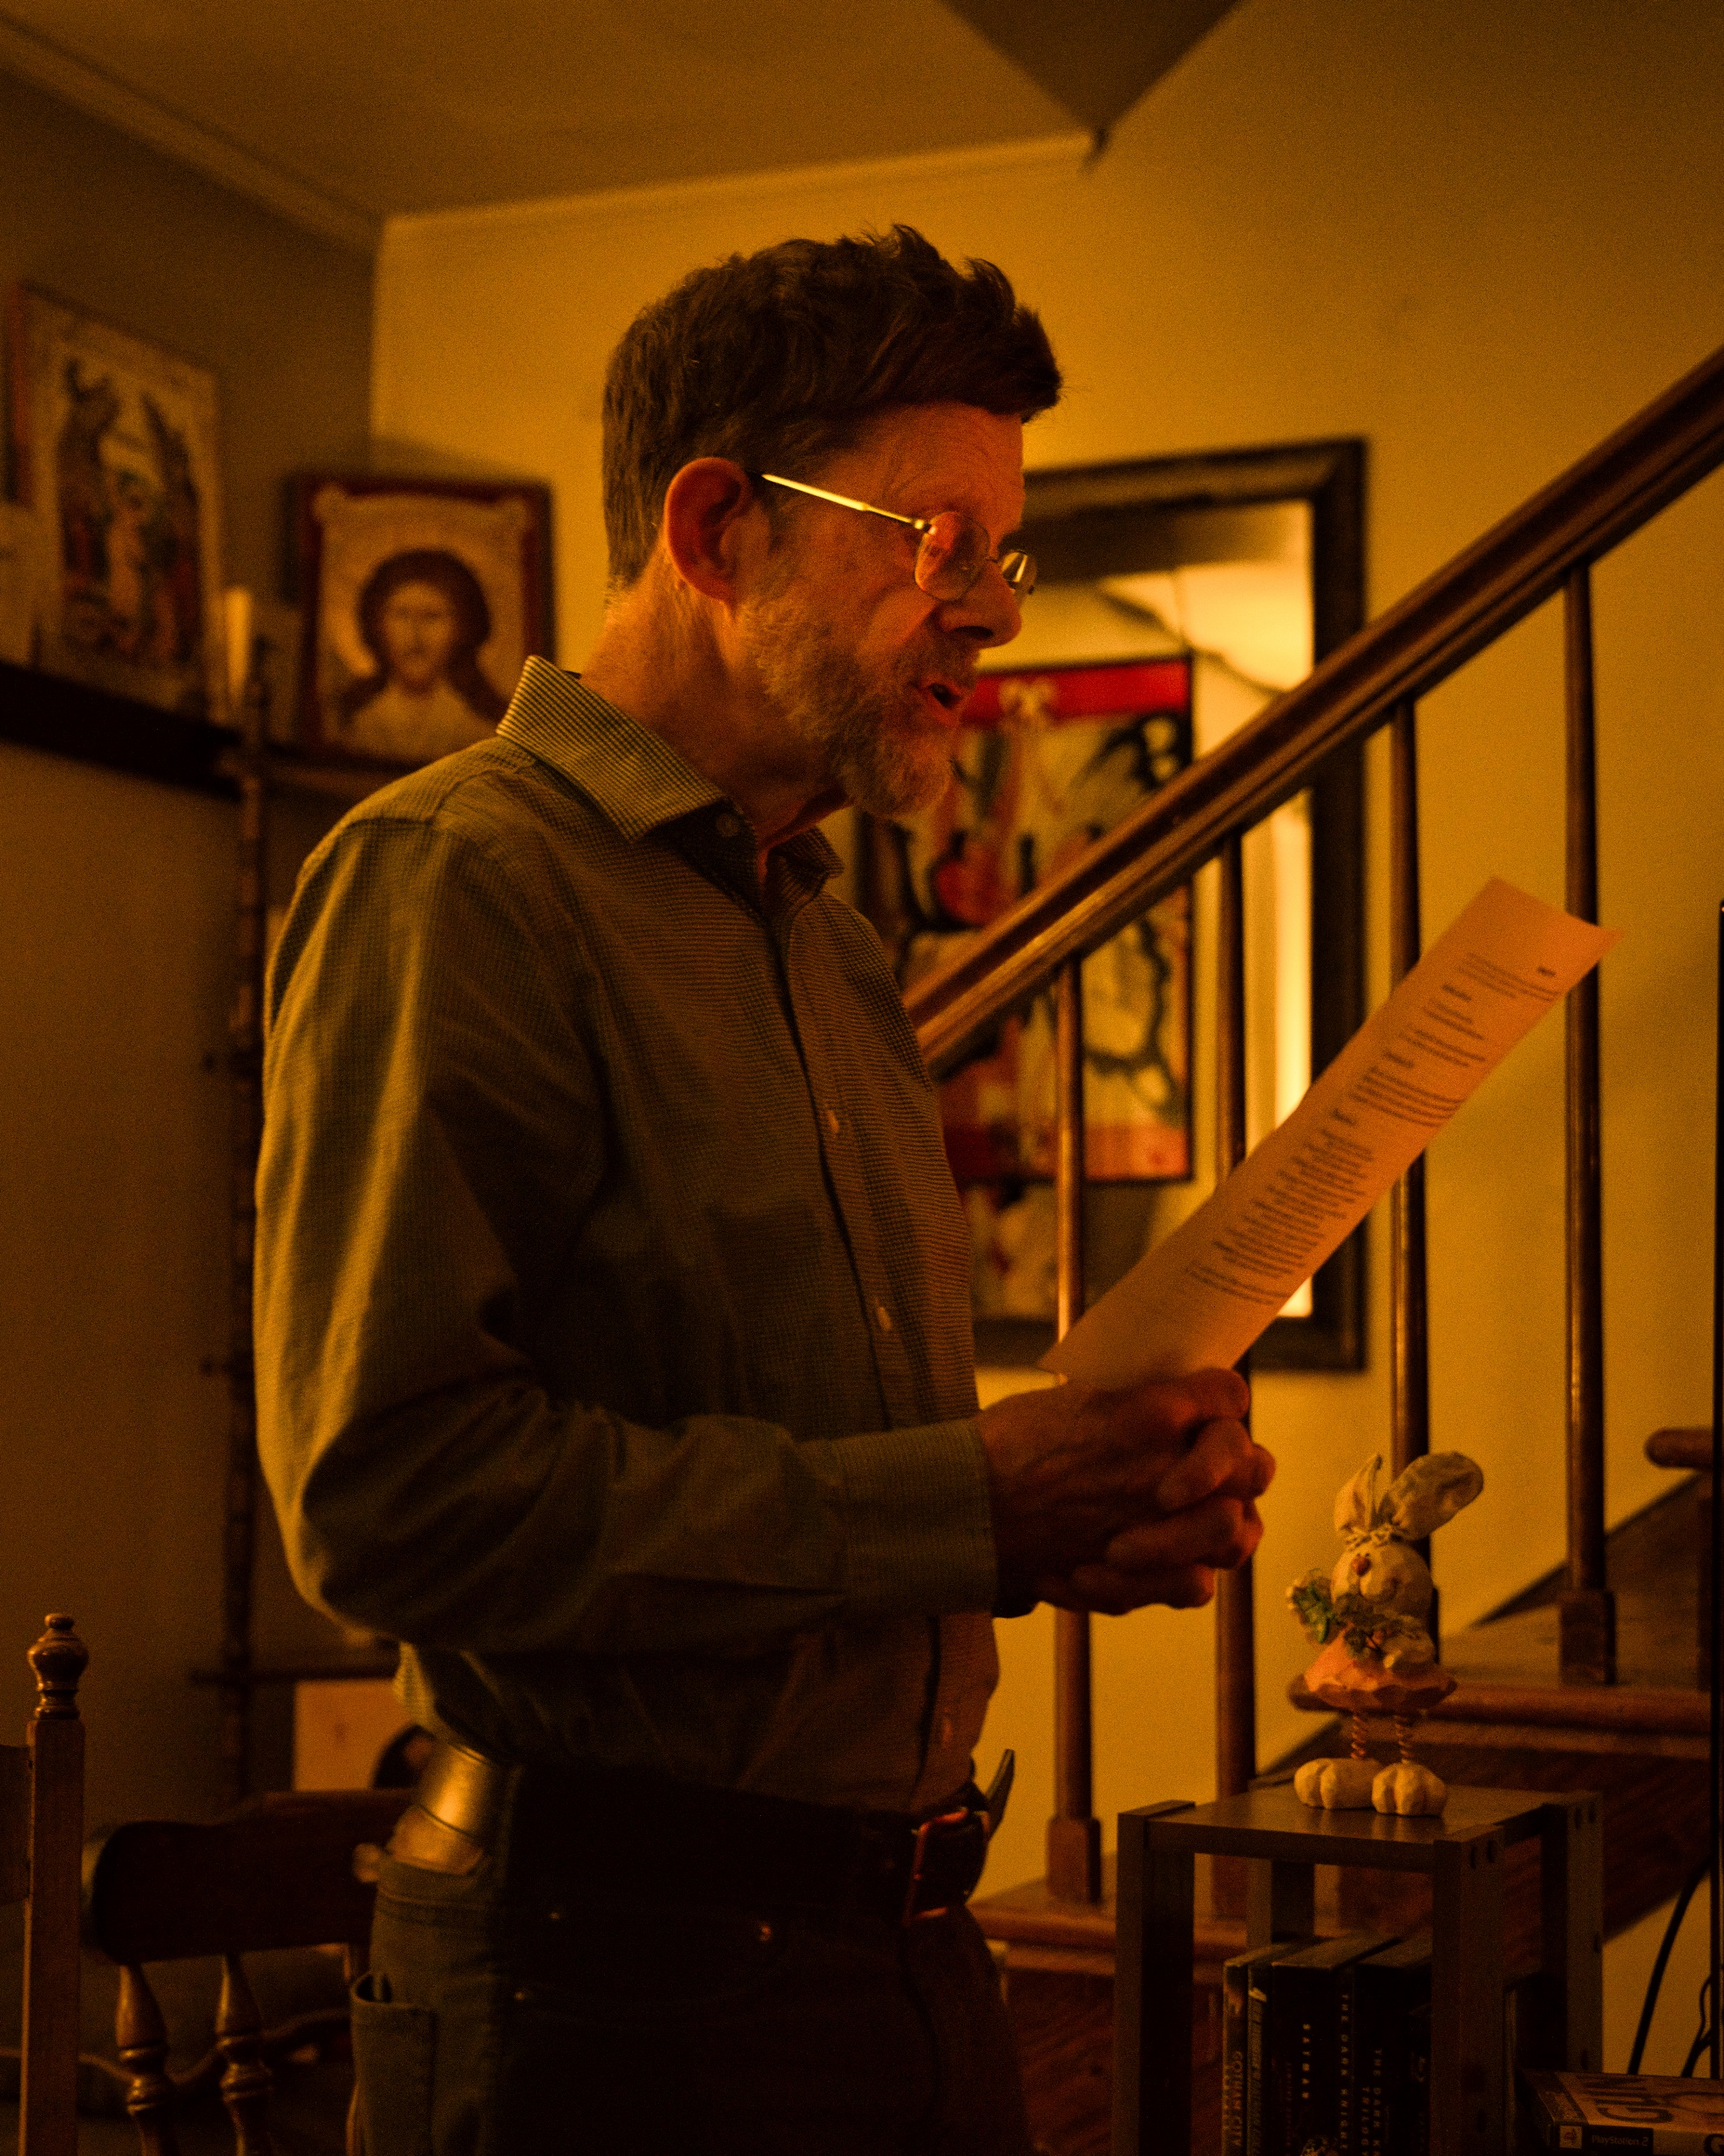
Example 2: The Stone and the Giant
The Stone and the Giant’s Pondering
This Pub is comprised of 15 members, but only 7 can attend on any average night. Its crew is more established, with several members being married and having kids. They need to have their kids in bed by bedtime, so they meet 6:00 Saturday nights.
People start arriving 5:45. This group decided to have a light meal together. This week, it is Ethan and Lexi’s turn to bring food.
The group says prayers at 6:00, and they have 3 presentations for the evening.

Slide 9
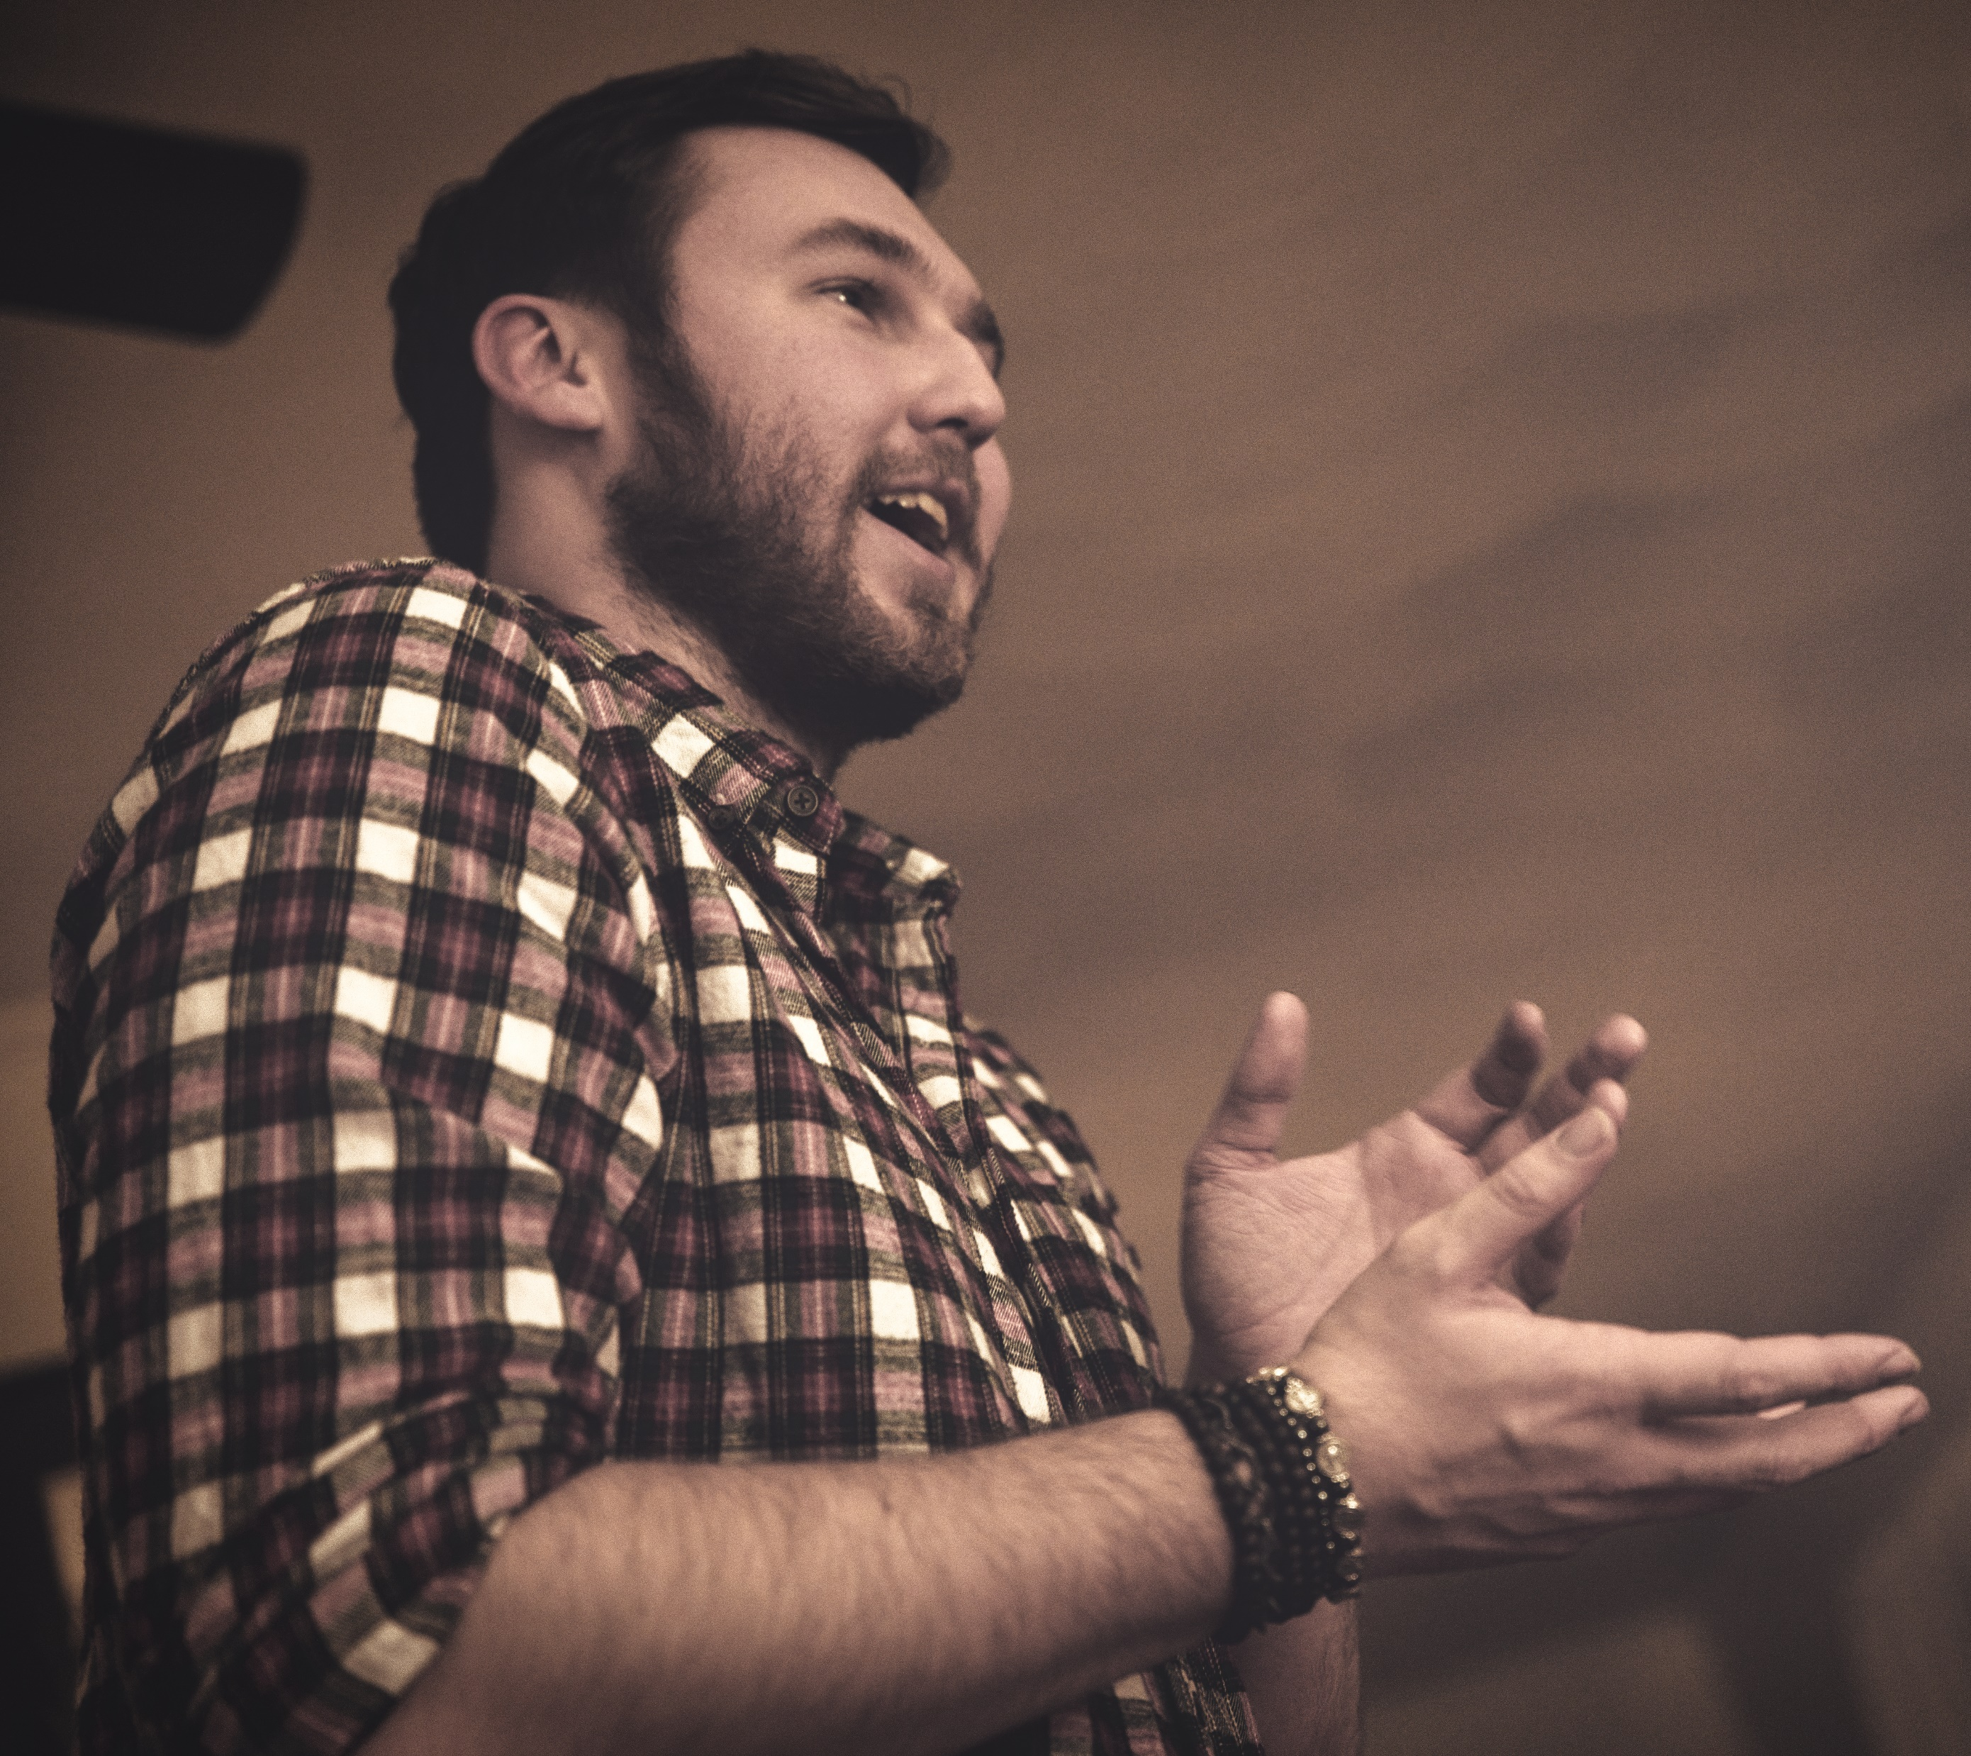
Example 2: The Stone and the Giant
The first presentation is by Ethan. He enjoys sketching people, and exaggerating certain features to bring out their “true” selves. He shows his art.
Second is Amy. She is very smart, and wrote a short piece about friendship. She reads it to the group.
Last is Paul. He saw a YouTube video that made him think. He showed it to the group, and prepared 4 discussion questions in light of what they just watched. The conversation lasts for hours. Those with kids leave when they must, and those without leave around 11.

Slide 10
Overview of Examples
In all of these examples, some aspect of the Divine must be brought out. Christ must be apparent in all of these. In Toms’ song, he brought out the goodness that comes from genuine, God-honoring labor. In Amy’s literature on friendship, she argued for the Truth of friendship being necessary.
The general premise went: People gathered at a house, shared cultural works of Truth, Beauty, and Goodness, and they enjoyed each other’s company.

Slide 11
Part 2
Ponderings at the Individual Level

Slide 12
Individual Pondering Structure
Rules aren’t needed for when things are good. They come in handy when things are bad. Here are the structures that constitute a Pondering:
Local Leadership
  All Pubs are comprised of 2 leadership positions: Host and Pub Representative.
  Host – Provides the physical location for the Pondering. Decides how the Prayer is said. Sets any House rules that must be followed. Schedules Ponderings.
  Pub Rep – Is the Point-of-Contact between that Pub and the greater Pondering Leadership. Also sets the agenda of the evening. Aids in the “flow” of the Pondering. Organizes the night.

Slide 13
Individual Pondering Structure
Agenda
  Prayer
  Announcements
  Presentations
    Art
    Music
    Literature
    Powerpoint
    Discussions
  Close

Slide 14
Individual Pondering Communication
The Pub leadership decides how often, when, and where Ponderings occur.
Each Pub falls under a region led by an Area Leadership Team. The Area Leadership Team provides resources, strategies, and support for Ponderings that fall under their umbrella.
  The Area Pub Leadership should meet with each individual Pub leadership team once a quarter. This ensures things are running smoothly. If there are issues, the Area Leadership uses its network of resources to aid that individual Pondering.
  The Pub Rep is the primary point of contact for the Area Leadership Team.

Slide 15
Individual Pondering Legal
If members of a Pondering would like to have their work published on the website or other social media platforms, they may submit their content through the website.
If a Pondering itself would like to have their own social media page, please consult your Pub Rep.
Individual Ponderings may NOT collect money. This is because we are a non-profit and this messes with our taxes.
Individual Ponderings are subject to any policies or bylaws their Area Leadership Team passes. This is required for legal reasons.
  If an Area Leadership Team passes a policy that an individual Pub feels unjust, they may petition it. Contact your Pub Rep.

Slide 16
Founder’s Tips: Size
The ideal Pondering size is between 4-10 people.
  Any fewer than 4 people, and we’ve found it’s hard to consistently bring new ideas to the table
  Any larger than 10 people, and people get left out of the main conversation.
  6 is the ideal size
Ponderings should have a “core group” of about 8-10 people. But 15-20 people consistently invited.
  This is because of the core group, 75% typically are able to come. Of the larger group, 1 or 2 people sometimes show up.

Slide 17
Part 3
The Pondering Pub at the Organizational Level

Slide 18
Organizational Level: Overview
The Pondering Pub is divided into 3 parts: The Board, The Staff, and The Leadership.
  Board – provides strategy and measurable checkpoints to grow the Pondering
  The Staff– carries out the functions of the Board.
  The Leadership – where all the individual ponderings, area leadership teams, and Ponderings are ran.
Leaders run the individual ponderings and are where all the attention is directed. Whenever a leader runs into an issue, the staff creates resources to help them address it. The board is there to provide overarching decisions and assist The Pondering Pub comply with legal and financial requirements.

Slide 19
Board
Provides Strategies and direction for the Pondering as a whole
Meets 2 times a year
(Some people are apart of multiple parts of leadership)
Executes the strategy of the Board
Fundraising, creating promotional videos, assisting Founders
Meets whenever their respective committee needs to
What the Pondering Pub is all about
Hosts Pubs that meet regularly, builds community, and creates works of culture
Leadership
Staff

Slide 20
Ponderings: Hierarchy
The Pondering Pub
Area Leadership Team
Individual Ponderings
For administrative purposes, the Pondering is broken up into 3 tiers.
Area Leadership teams preside over a region. They aid new Founders start pubs, and help keep alive current ones.
There will be multiple Ponderings that fall under one Area Leadership Team.

Slide 21
Pondering Hierarchy: Area Leadership Team
The Area Leadership Team is comprised of a President, VP, Secretary, and Treasurer.
  These people are allowed to collect money for the Pondering, aid in administration, and are responsible for all legal occurrences within their areas.
They are to meet with each Pub Rep in their area at least once every three months. Both to aid in mentorship, morale, and resources.
The president of each Area Leadership Team is to give a report at all board meetings.

